Slide 1
REACT PROJECT
Renewable Energy for self-sustAinable island CommuniTies
Dr. Stergios Vakalis (Assistant Professor)
Energy Management Laboratory, Low Carbon Energy Technologies
Department of Environment, University of the Aegean

Slide 2
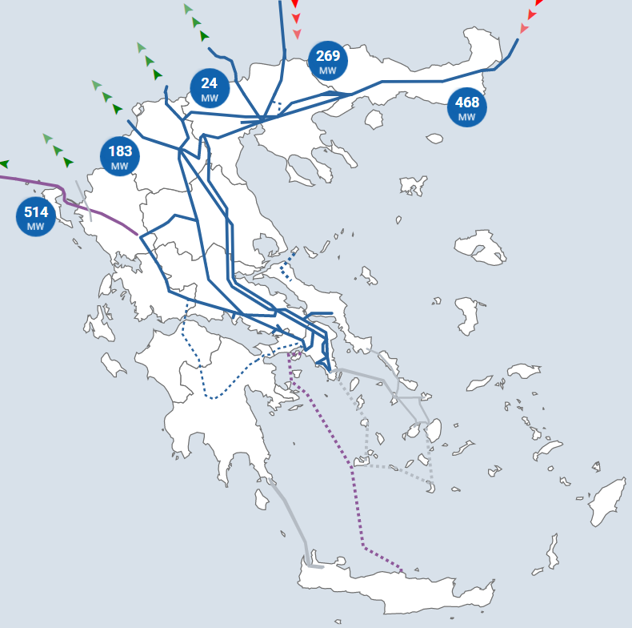
Energy mix in Greece
24-2-2002

Slide 3
Energy production in islands
The production is mainly done by Diesel and HFO engines
RES have modest penetration
The price of electricity production can be up to 400% more in comparison to the mainland
The Greek National Plan is to connect most islands with the mainland grid

Slide 4
Green Energy Transition Islands (examples)
The non-interconnected islands are planned to become green islands and smart islands
RES installations
E-mobility
Energy storage
District heating
Smart monitoring
*Non – Interconnected Islands

Slide 5
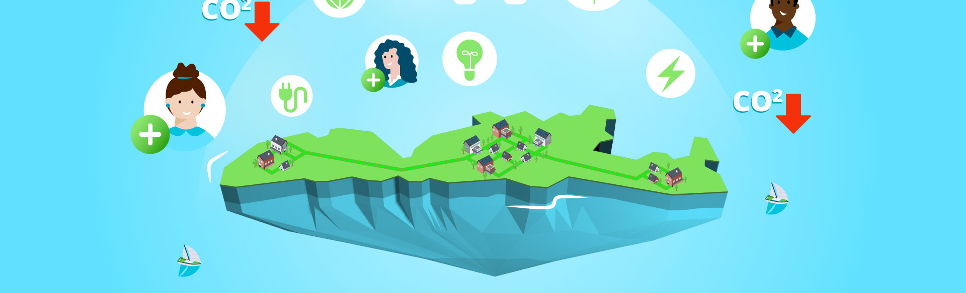
The REACT project
Renewable Energy for Self-Sustainable Island Communities
24 Partners, 11 EU countries, 8 different islands
Installation of RES in residential & public buildings
Smart – use with energy meters and a demand/ response software

Slide 6
REACT project – short video

Slide 7
The REACT pilot islands
Lesvos - Gotland - Mallorca –
La Reunion – Isle of Wight
3 islands were selected to be pilot islands for the project
Inis Mor, San Pietro and La Graziosa
We installed RES in residential and public buildings
We connected smart / online meters for 24/7 monitoring
We developed a dedicated software for optimal use of home devices

Slide 8
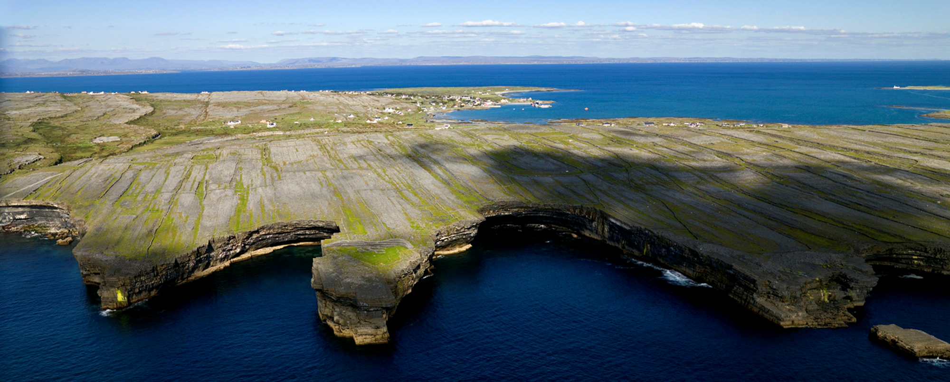
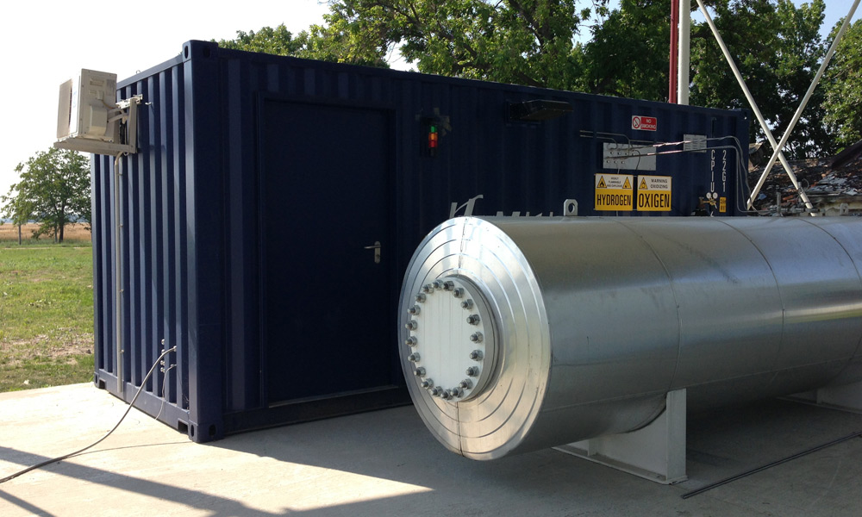
Pilot island – Inis Mor
PV panels
Batteries
Hydrogen

Slide 9
Power – to – Hydrogen

Slide 10
Online monitoring/ Smartphone App
A short presentation of the Smartphone App (will be available in App Store and
Google Play) will be done at 16.45!

Slide 11
The REACT solution

Slide 12
THANK YOU FOR YOUR ATTENTION
vakalis@aegean.gr
Prof. Stergios Vakalis (Assistant Professor)
Energy Management Laboratory, Low Carbon Energy Technologies
Department of Environment, University of the Aegean

